Slide 1






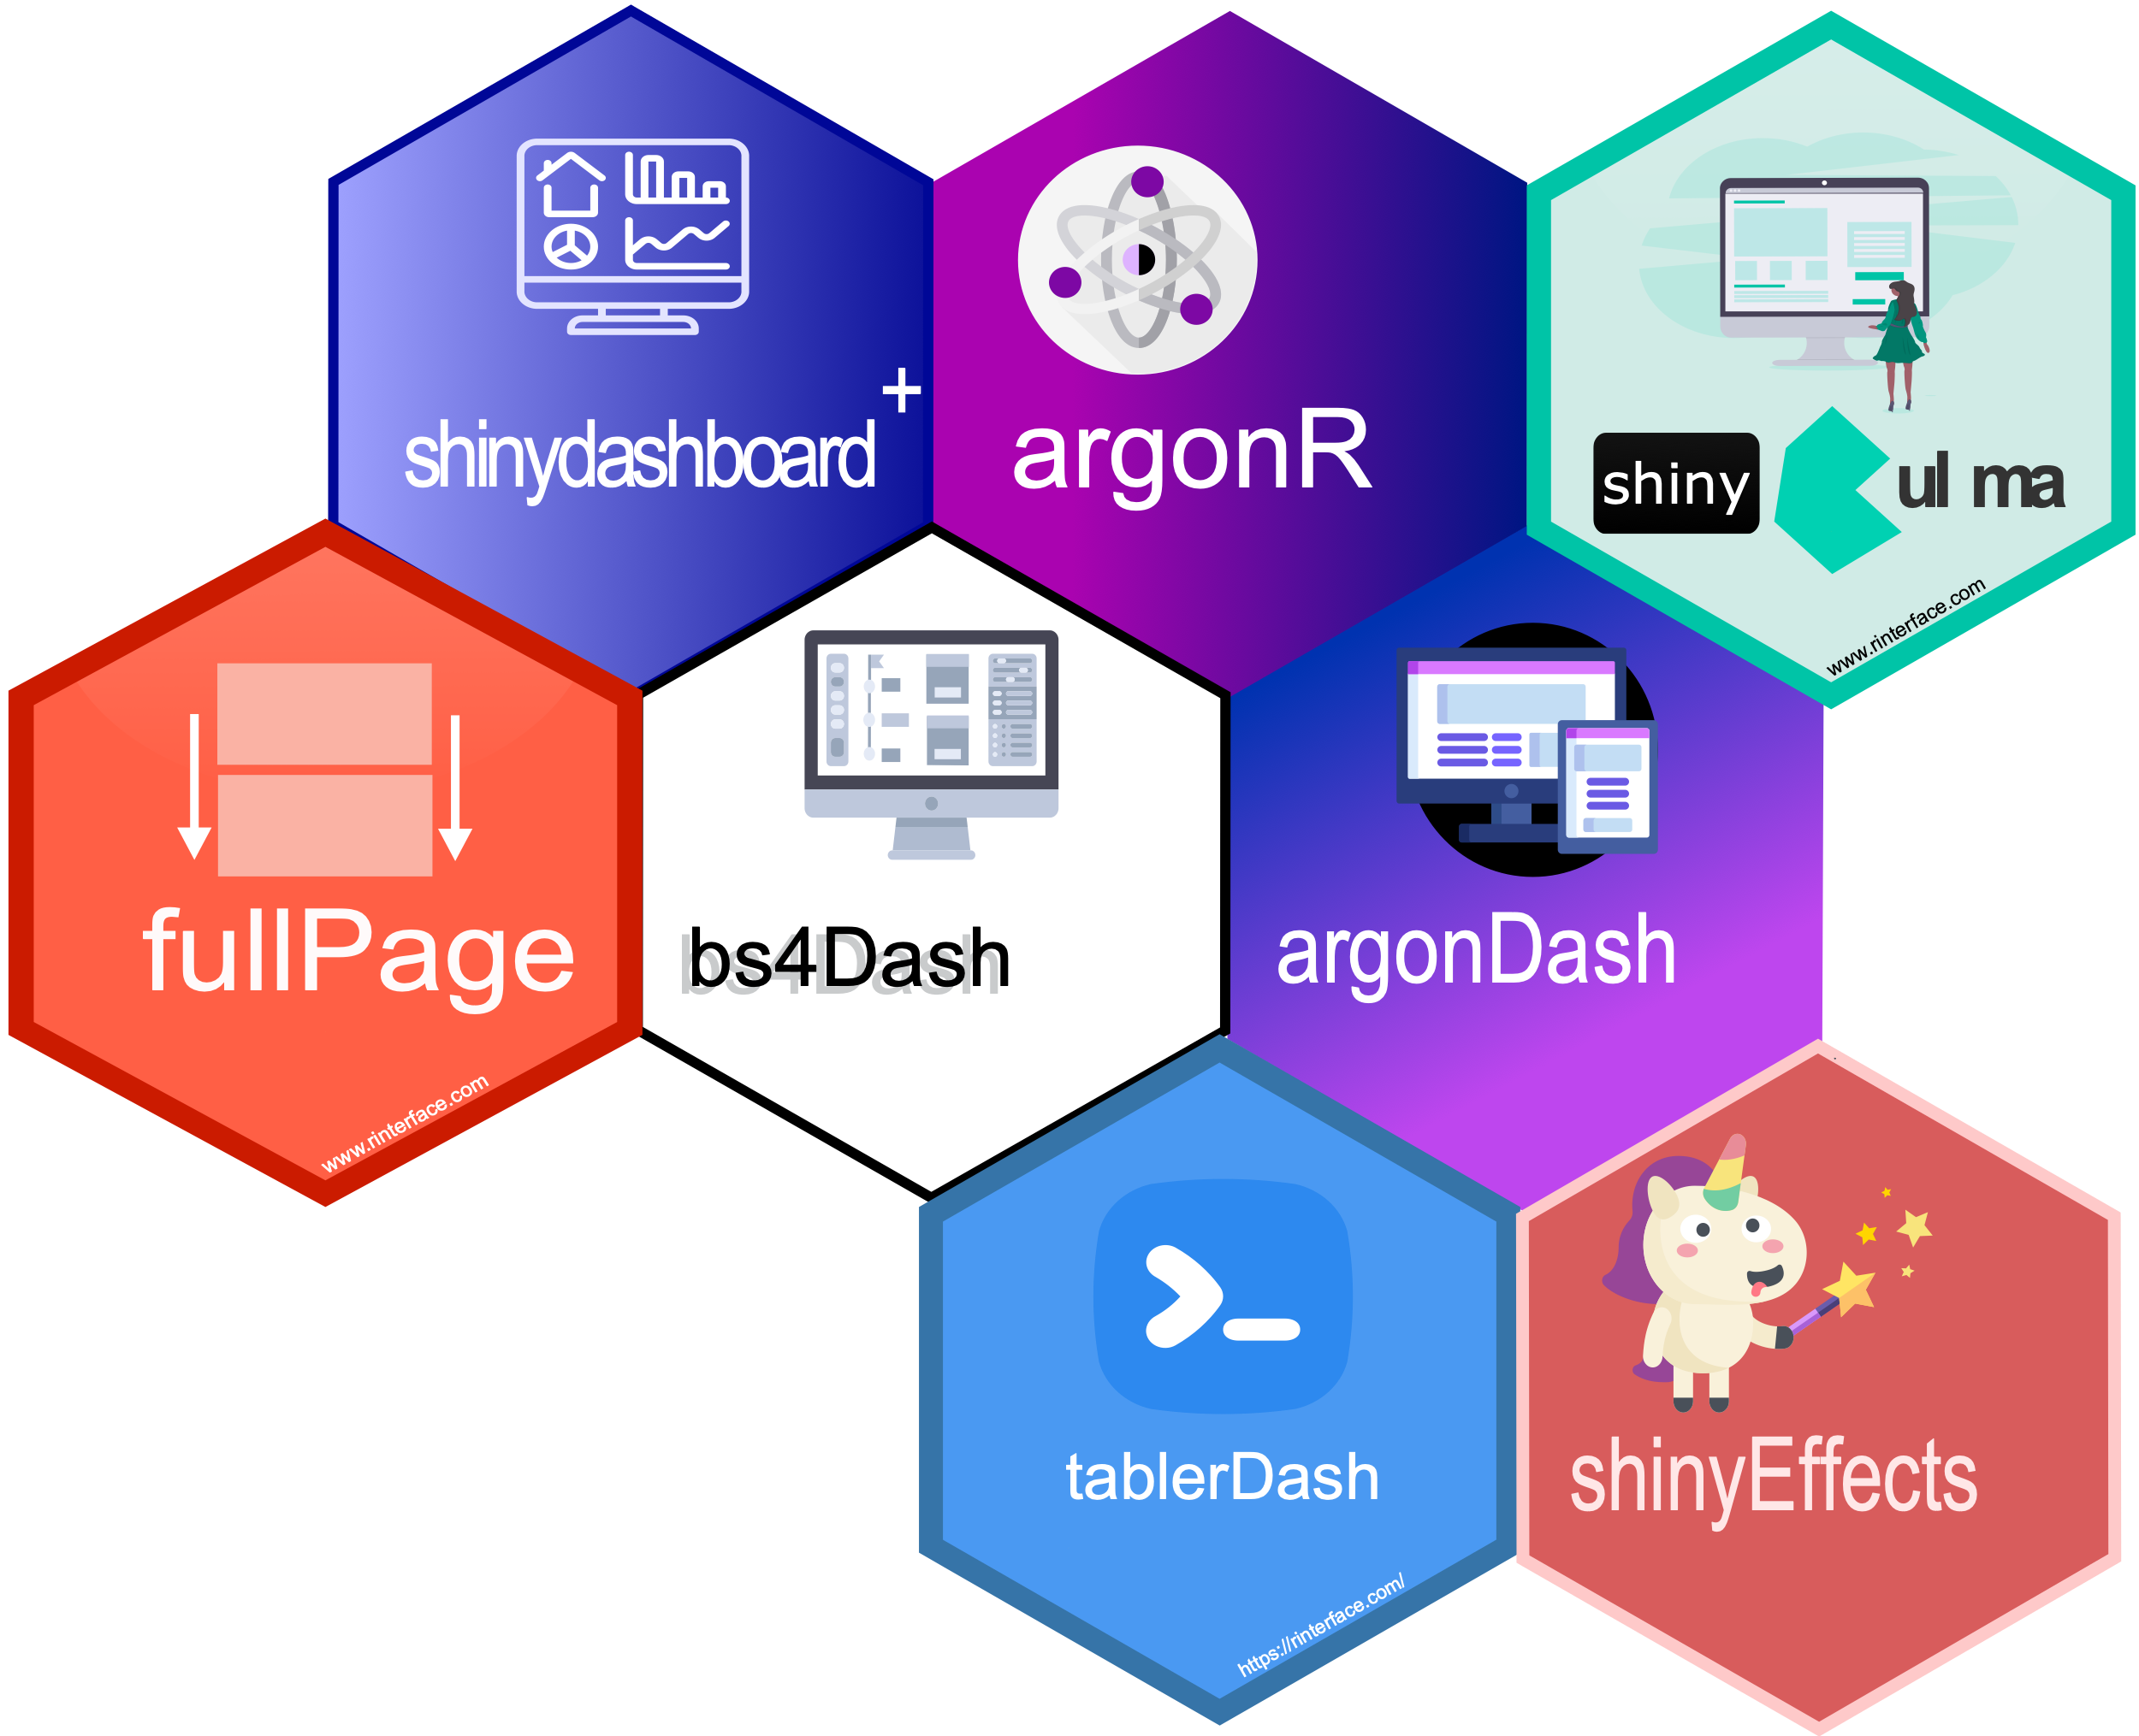

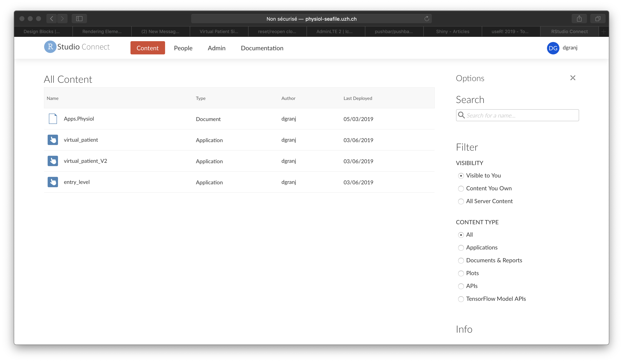
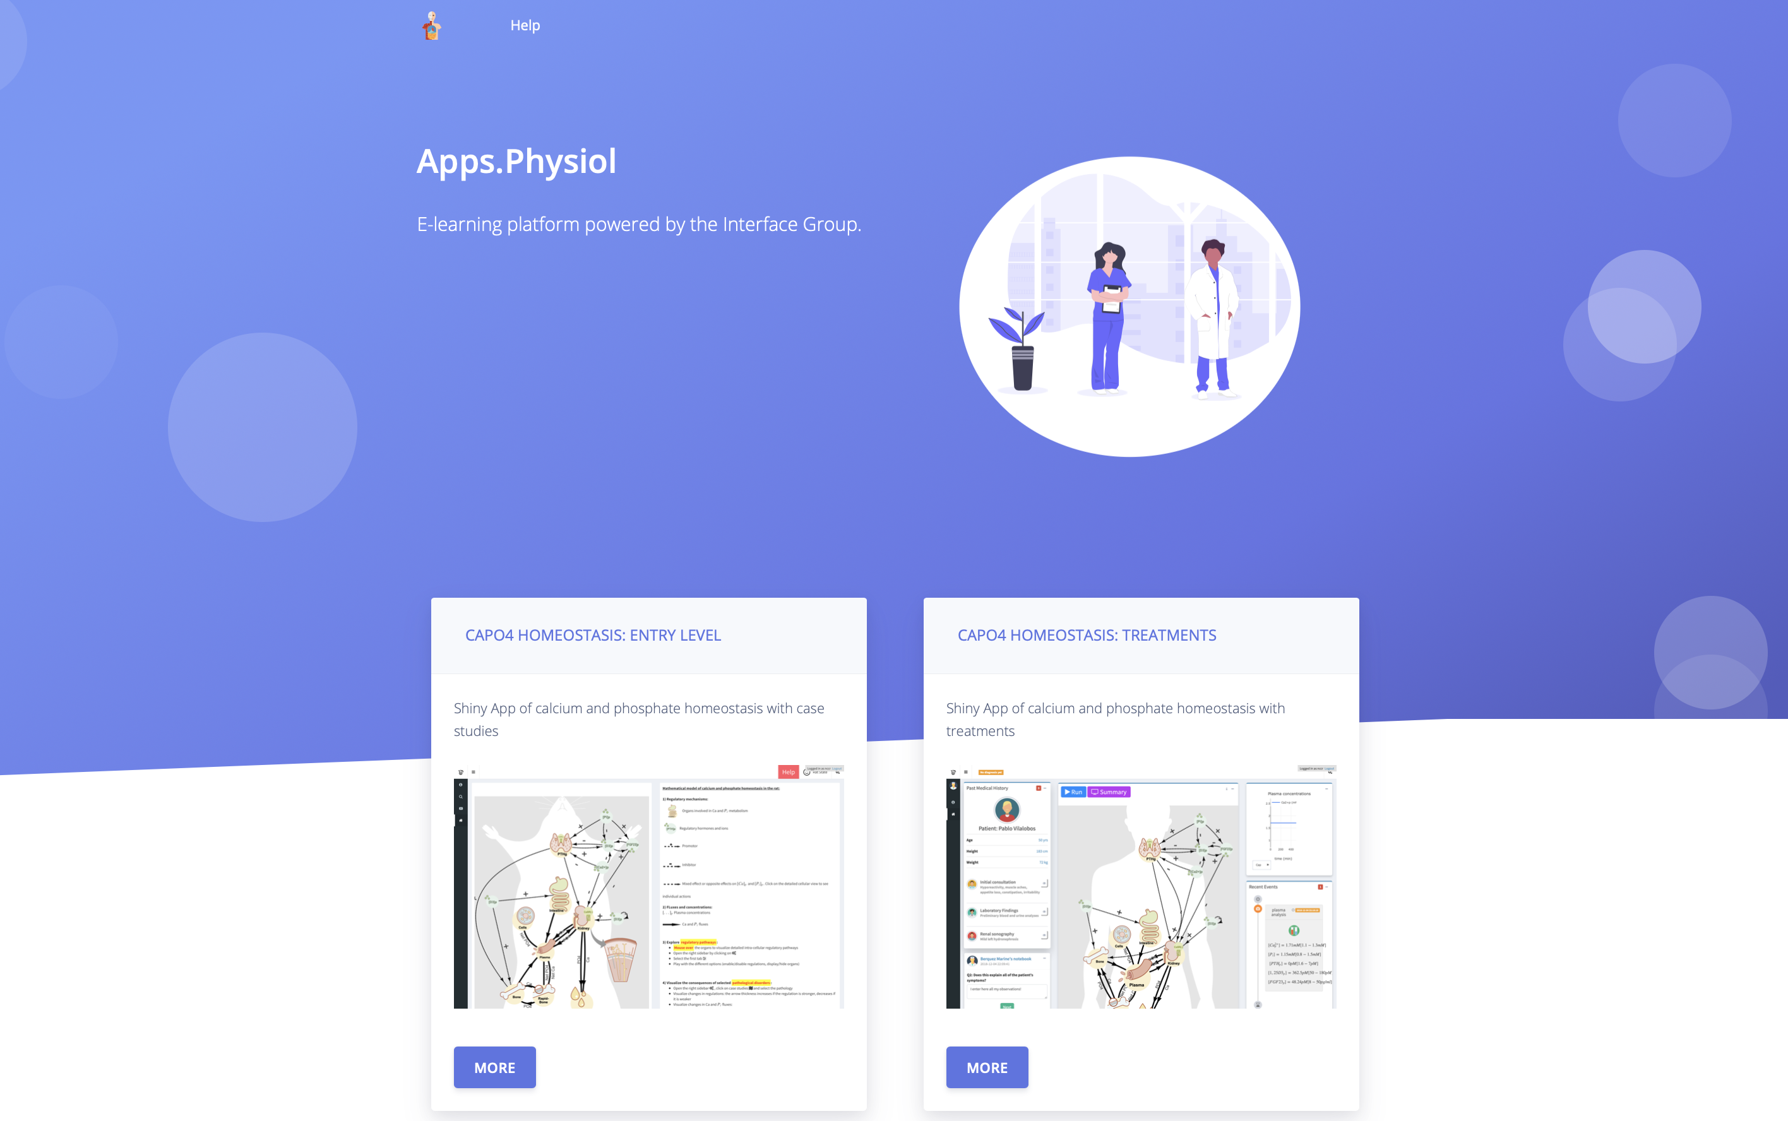
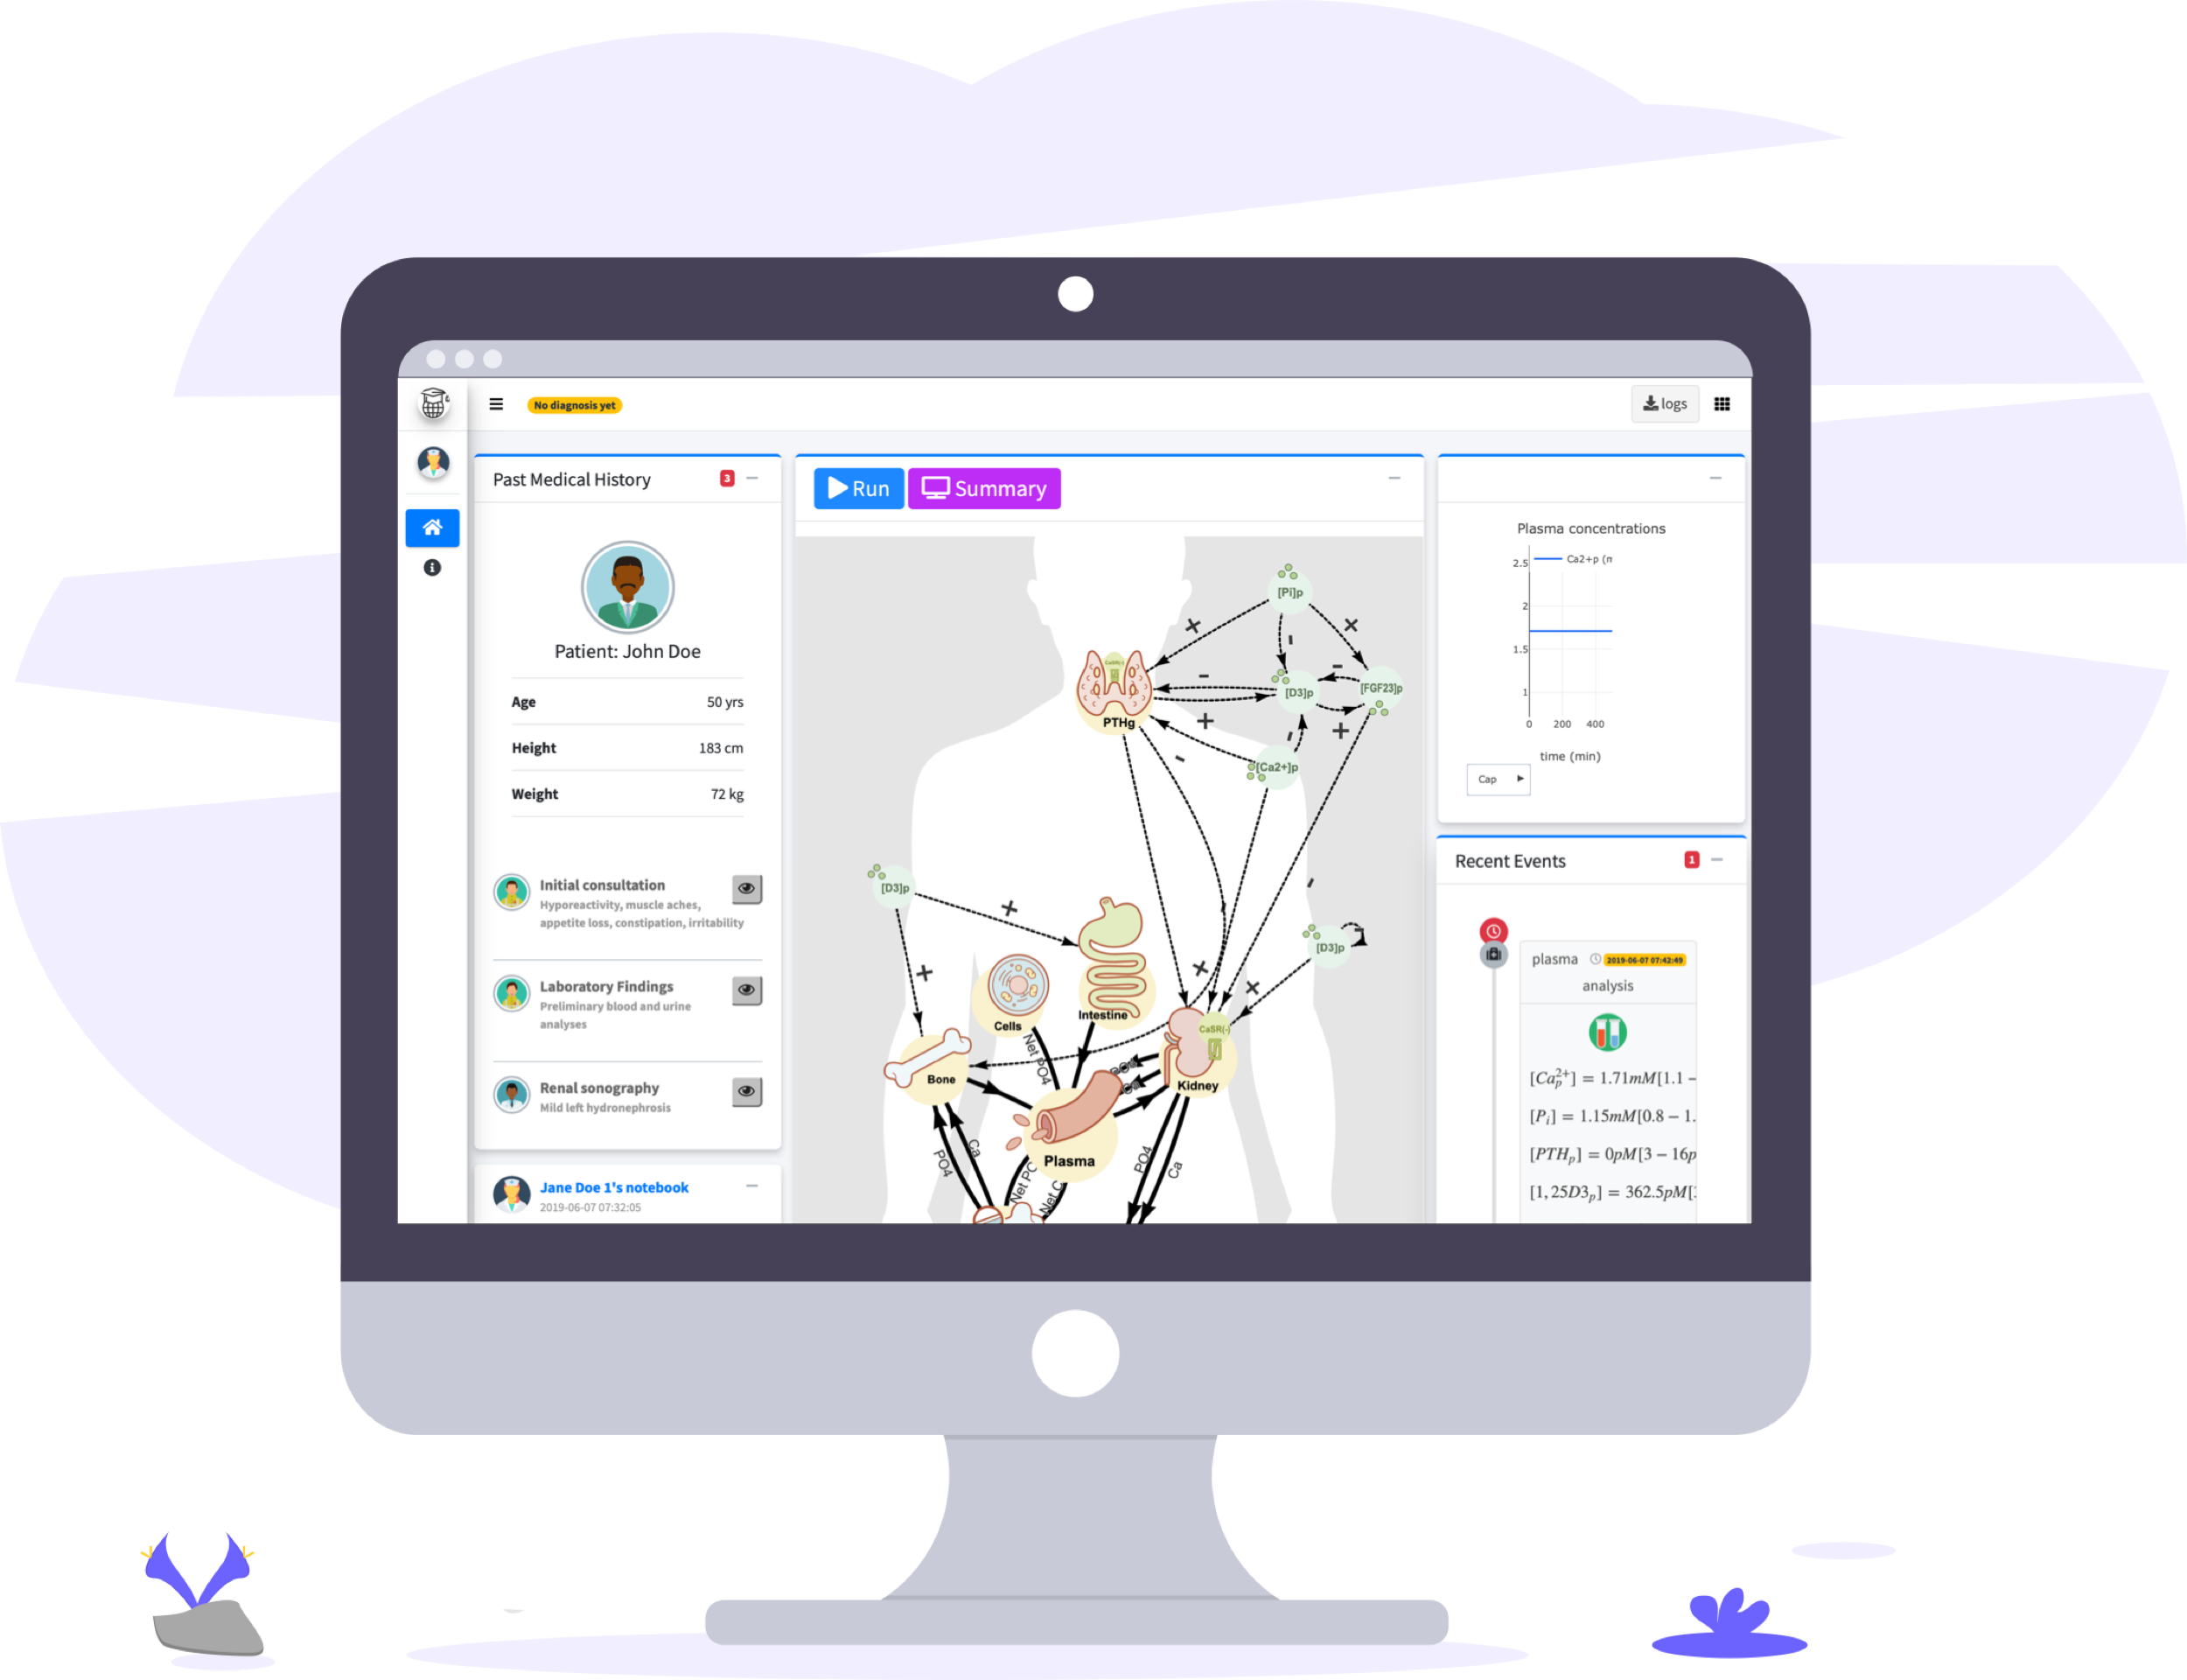
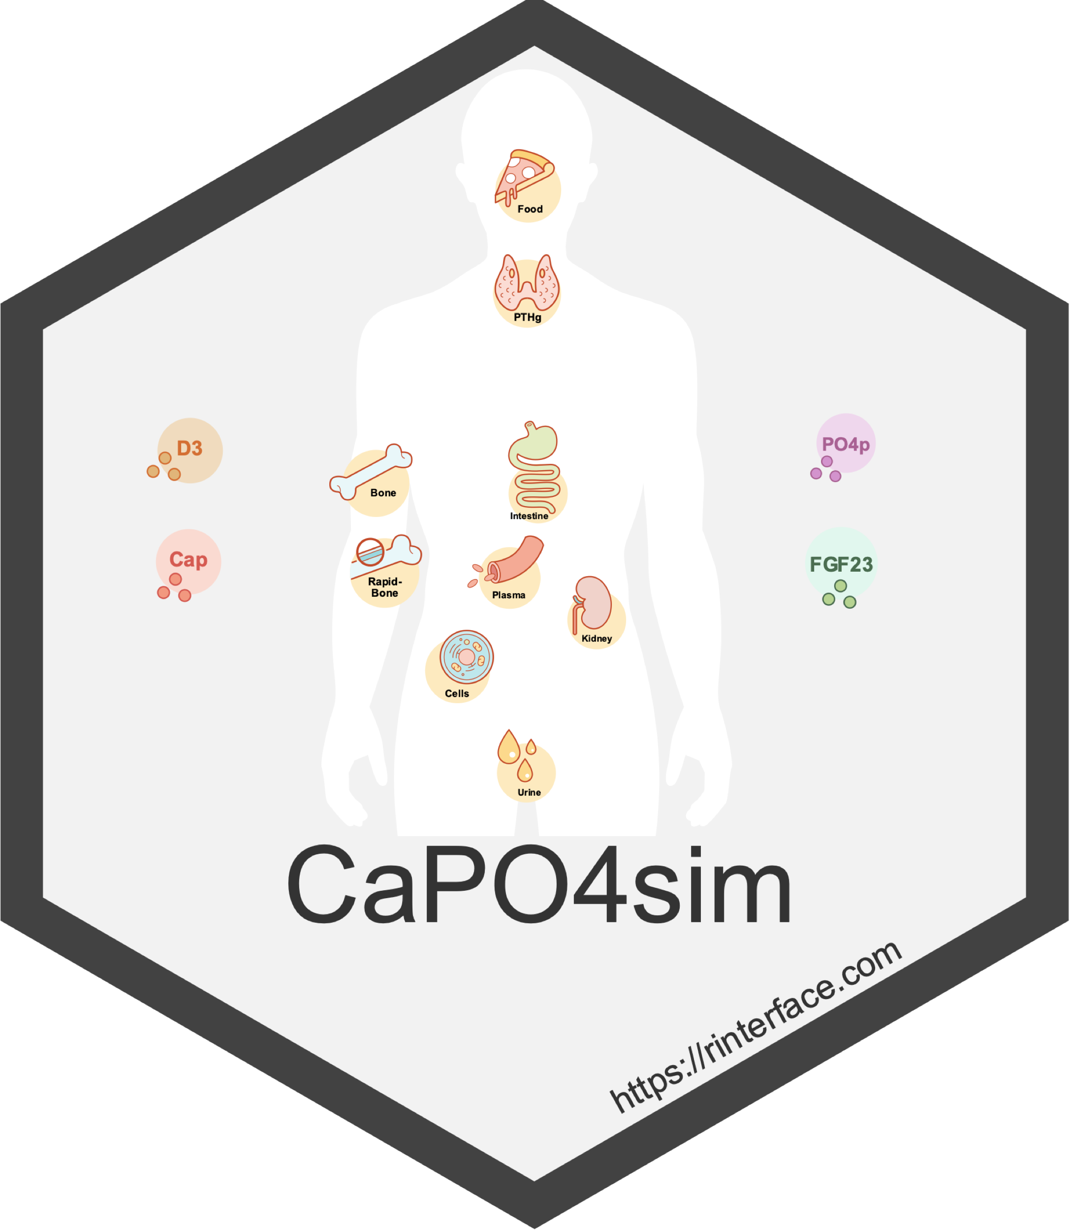




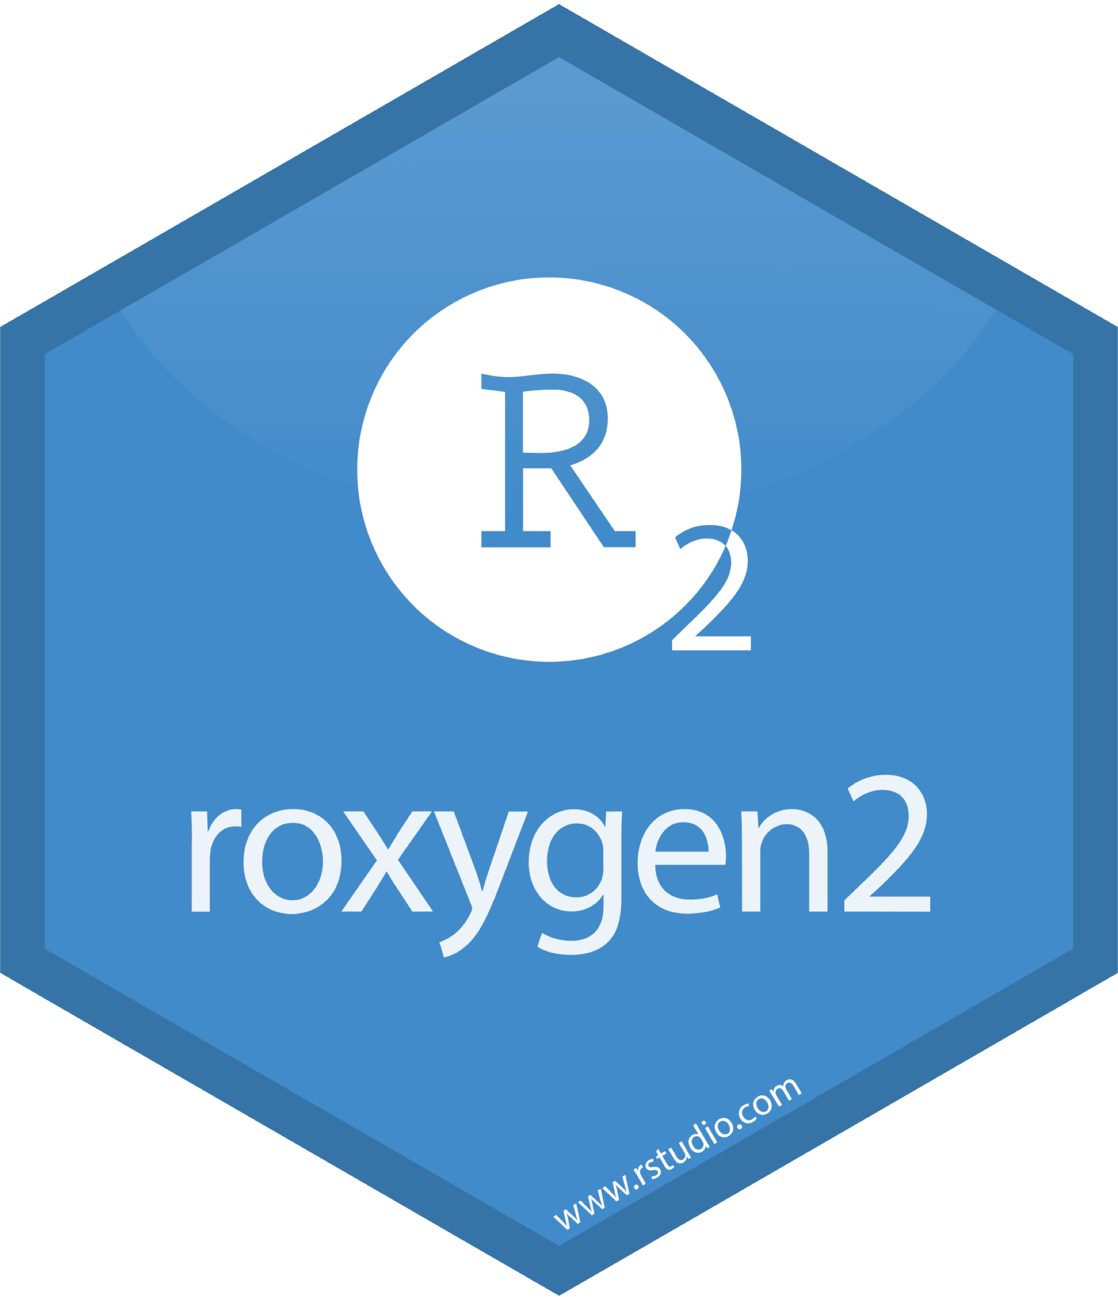
Shiny Powered eLearning Platform to Teach Calcium and Phosphate Homeostasis.
David Granjon¹, Olivier Bonny², François Verrey¹, Vartan Kurtcuoglu¹ and Diane de Zélicourt¹
1. Institute of Physiology, University of Zurich, Zurich, Switzerland; 2. Département de Pharmacologie et Toxicologie, Université de Lausanne
Novel Shiny templates
Hosting
Objectives
To develop an interactive and participatory web-based eLearning tool allowing students to simulate physiologic function as well as pathologic changes in the control of Ca-P homeostasis (1), and thereby consolidate information conveyed in the lecture.
RinteRface provides a set of novel HTML templates to develop outstanding and modern dashboards.
App Features
Basic principle:
Virtual patient study
Main workflow:
“Virtual patients” are randomly assigned or can be constrained by the teacher to a specific one (e.g. collaborative group work)
Carefully read the patient presentation
Establish diagnosis
Propose treatments
Easily extendable:
Possibility for the teacher to add a new virtual patient case
Outlook
This new tool is a first step toward:
Including more biological mechanisms as well as generalizing to other topics
Providing predictive apps to assist patients
Developing elegant templates for shiny that can scale on all platforms (desktop, tablets, …)
Establishing a relevant workflow to build robust and modularized shiny apps
References
Granjon D, Bonny O and Edwards A. Coupling between phosphate and calcium homeostasis: a mathematical model. Am J Physiol Renal Physiol, 2017, 313: 1181-1199.

